Slide 1
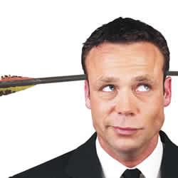
HUMOR IN PREACHING
254
Dr. Rick Griffith Jordan Evangelical Theological Seminary
BibleStudyDownloads.org

Slide 2
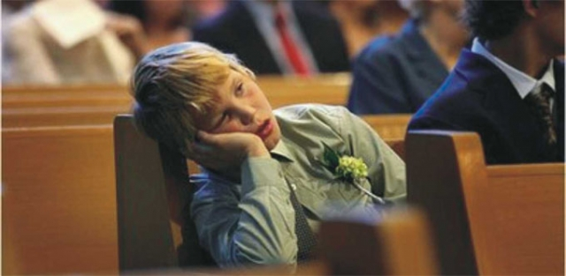
How can we wake them up?
Notes:
Laughter is good medicine for us all—but especially for youth and kids who think church is boring.
Somehow church is one od the sleepiest places on earth—so how can we wake them up?

Slide 3
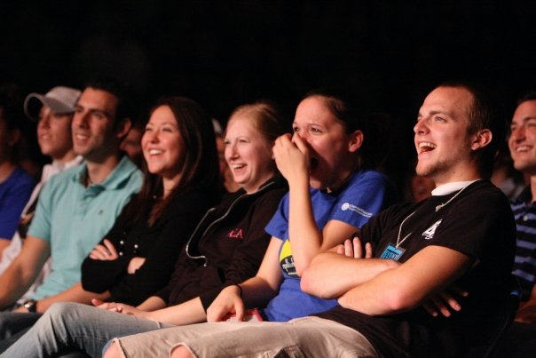
Humour them!
Notes:
Laughing is one of the best ways to keep your audience’s attention.

Slide 4
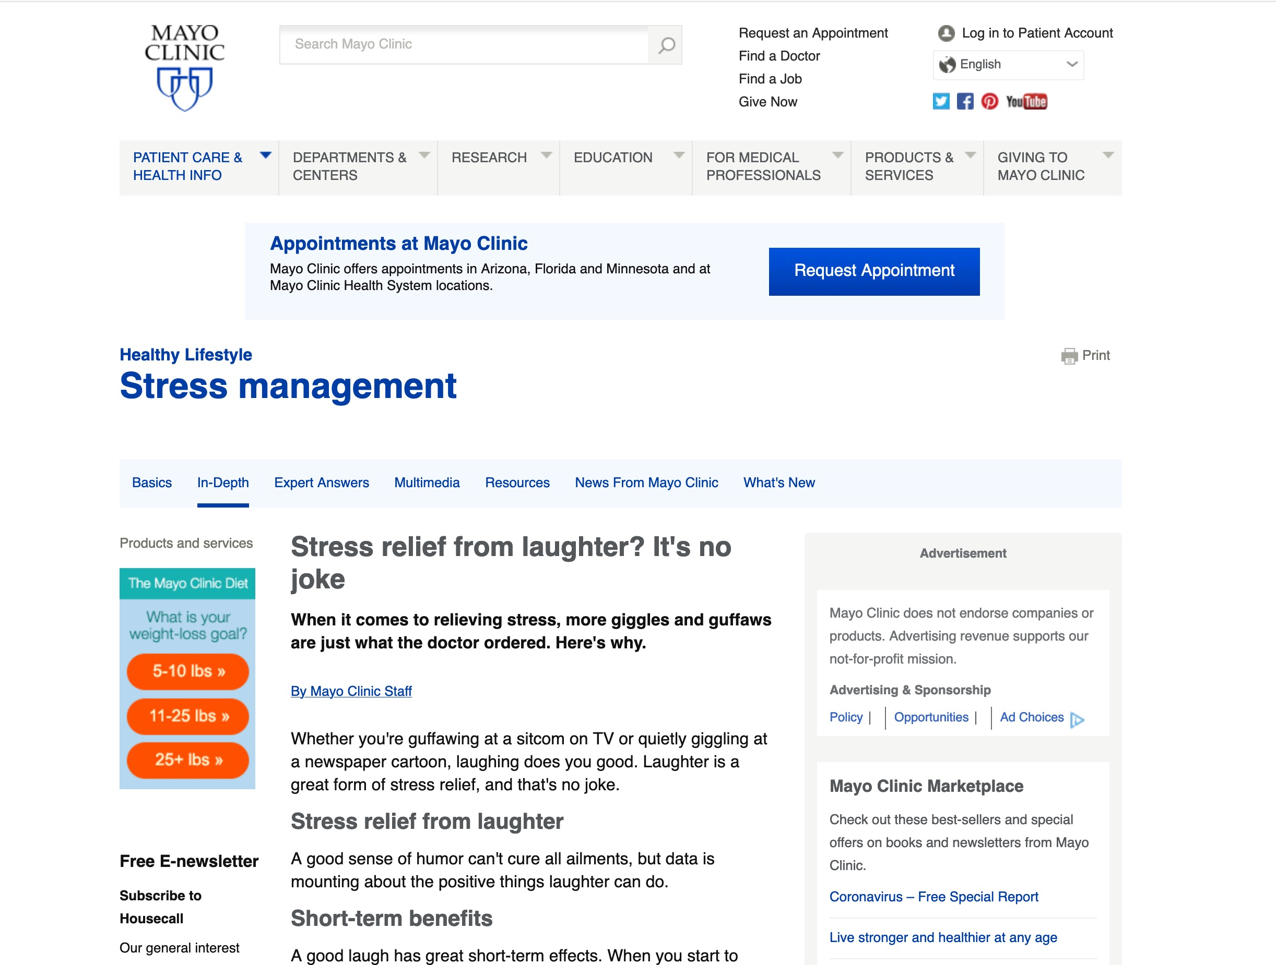
Stress relief from laughter? It's no joke.
Notes:
Stress relief from laughter? It's no joke
When it comes to relieving stress, more giggles and guffaws are just what the doctor ordered. Here's why.
By Mayo Clinic Staff
Whether you're guffawing at a sitcom on TV or quietly giggling at a newspaper cartoon, laughing does you good. Laughter is a great form of stress relief, and that's no joke.
Stress relief from laughter
A good sense of humor can't cure all ailments, but data is mounting about the positive things laughter can do.
Short-term benefits
A good laugh has great short-term effects. When you start to laugh, it doesn't just lighten your load mentally, it actually induces physical changes in your body. Laughter can:
Stimulate many organs. Laughter enhances your intake of oxygen-rich air, stimulates your heart, lungs and muscles, and increases the endorphins that are released by your brain.
Activate and relieve your stress response. A rollicking laugh fires up and then cools down your stress response, and it can increase and then decrease your heart rate and blood pressure. The result? A good, relaxed feeling.
Soothe tension. Laughter can also stimulate circulation and aid muscle relaxation, both of which can help reduce some of the physical symptoms of stress.
Long-term effects
Laughter isn't just a quick pick-me-up, though. It's also good for you over the long term. Laughter may:
Improve your immune system. Negative thoughts manifest into chemical reactions that can affect your body by bringing more stress into your system and decreasing your immunity. By contrast, positive thoughts can actually release neuropeptides that help fight stress and potentially more-serious illnesses.
Relieve pain. Laughter may ease pain by causing the body to produce its own natural painkillers.
Increase personal satisfaction. Laughter can also make it easier to cope with difficult situations. It also helps you connect with other people.
Improve your mood. Many people experience depression, sometimes due to chronic illnesses. Laughter can help lessen your depression and anxiety and may make you feel happier.
Improve your sense of humor
Are you afraid you have an underdeveloped — or nonexistent — sense of humor? No problem. Humor can be learned. In fact, developing or refining your sense of humor may be easier than you think.
Put humor on your horizon. Find a few simple items, such as photos, greeting cards or comic strips, that make you chuckle. Then hang them up at home or in your office. Keep funny movies, books, magazines or comedy videos on hand for when you need an added humor boost. Look online at joke websites. Go to a comedy club.
Laugh and the world laughs with you. Find a way to laugh about your own situations and watch your stress begin to fade away. Even if it feels forced at first, practice laughing. It does your body good.
Consider trying laughter yoga. In laughter yoga, people practice laughter as a group. Laughter is forced at first, but it can soon turn into spontaneous laughter.
Share a laugh. Make it a habit to spend time with friends who make you laugh. And then return the favor by sharing funny stories or jokes with those around you.
Knock, knock. Browse through your local bookstore or library's selection of joke books and add a few jokes to your list that you can share with friends.
Know what isn't funny. Don't laugh at the expense of others. Some forms of humor aren't appropriate. Use your best judgment to discern a good joke from a bad or hurtful one.
Laughter is the best medicine
Go ahead and give it a try. Turn the corners of your mouth up into a smile and then give a laugh, even if it feels a little forced. Once you've had your chuckle, take stock of how you're feeling. Are your muscles a little less tense? Do you feel more relaxed or buoyant? That's the natural wonder of laughing at work.
Published 5 April 2019
https://www.mayoclinic.org/healthy-lifestyle/stress-management/in-depth/stress-relief/art-20044456
Accessed 21 April 2020

Slide 5
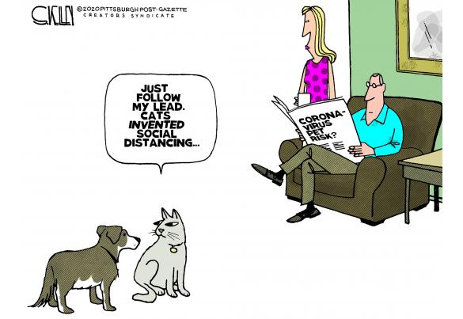
COVID-19
Just follow my lead. Cats invented social distancing.
Notes:
Restatement

Slide 6
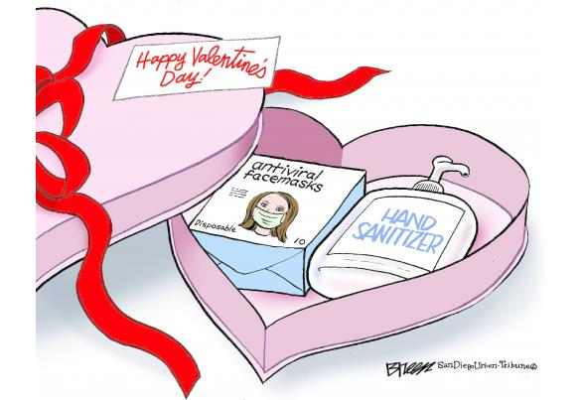
COVID-19
Notes:
Restatement

Slide 7
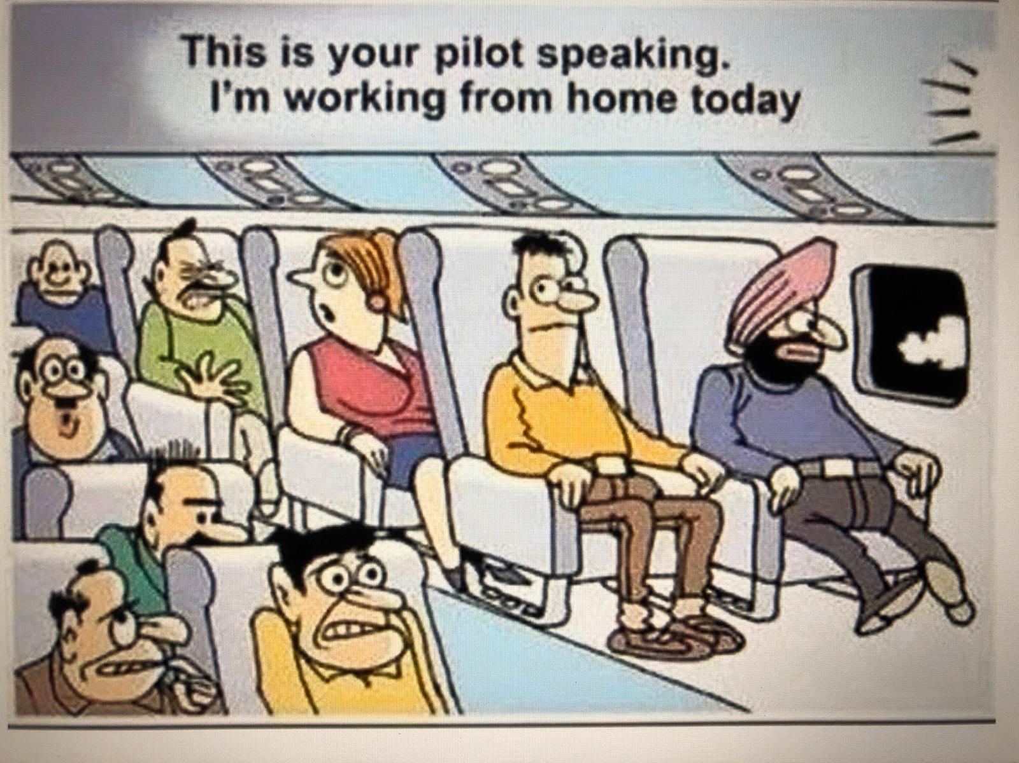
COVID-19
This is your pilot speaking. I'm working from home today.
Notes:
Restatement

Slide 8
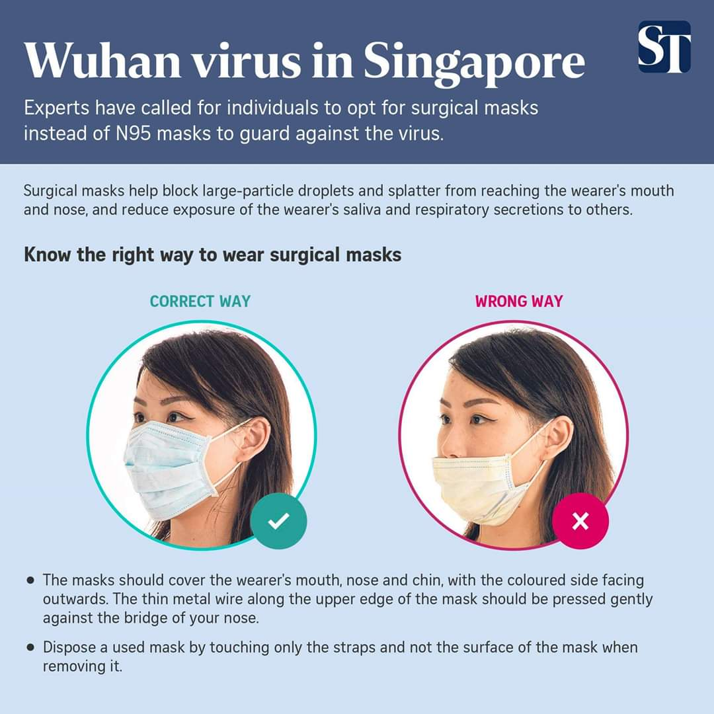
COVID-19
Know the right way to wear surgical masks
CORRECT WAY
WRONG WAY
Notes:
Restatement

Slide 9
COVID-19
Please wear a mask at home too…
Especially when alone…
It will stop you from eating more!
Notes:
Restatement

Slide 10
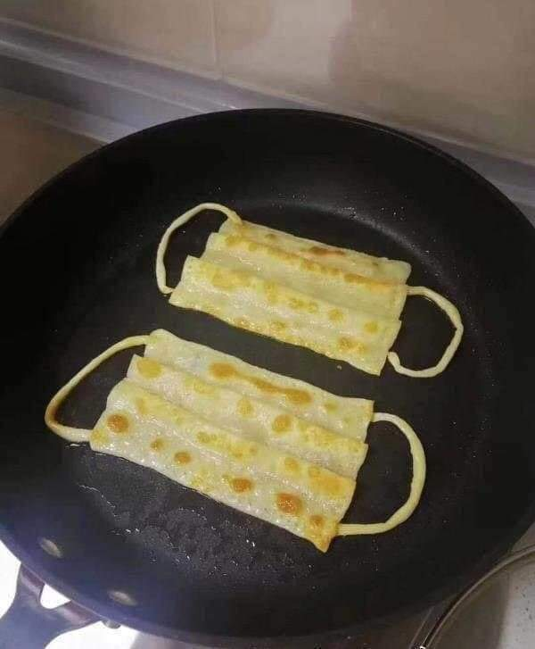
Prata Masks
Notes:
Restatement

Slide 11
COVID-19
Do you know why the USA has more COVID cases than Japan?
USA vs JAPAN
Look at the way they wear masks.
Notes:
Restatement

Slide 12
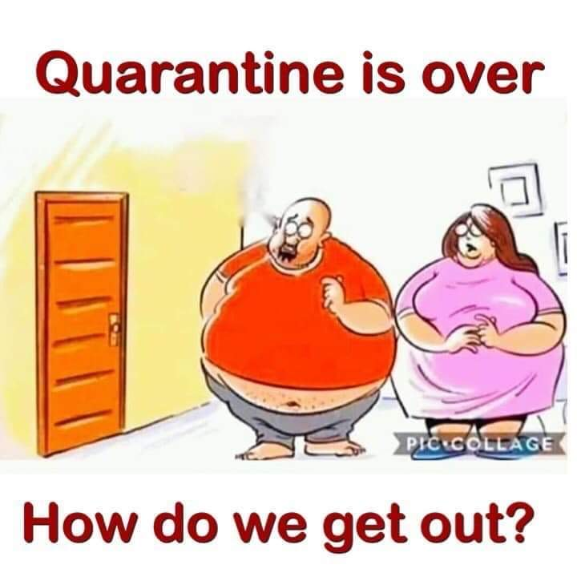
COVID-19
The quarantine is over.
Now how do we get out?
Notes:
Restatement

Slide 13
COVID-19
Notes:
Restatement

Slide 14
I'm going to the store. Do you want anything?
Notes:
Restatement

Slide 15
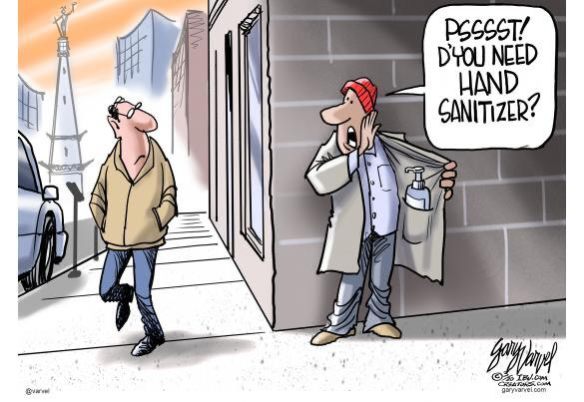
COVID-19
Psssst! D'you need hand sanitizer?
Notes:
Restatement

Slide 16
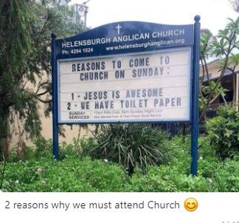
COVID-19
Two reasons we must attend church.
Notes:
Restatement

Slide 17
My mother went to live with my brothers and packed accordingly
Notes:
Restatement

Slide 18
Try your luck.
Notes:
Restatement

Slide 19
COVID-19
Toilet paper $3999
Free: One Carat Diamond Ring with Purchase
Notes:
Restatement

Slide 20
COVID-19
The FEDS sent you $1000, and you blew it on toilet paper?!
Notes:
Restatement

Slide 21
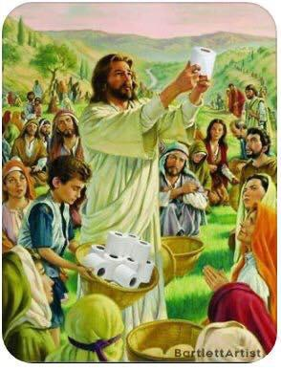
COVID-19
Notes:
Restatement

Slide 22
COVID-19
And Jesus said, "Unbind him…
…We really need the toilet paper."
Notes:
Restatement

Slide 23
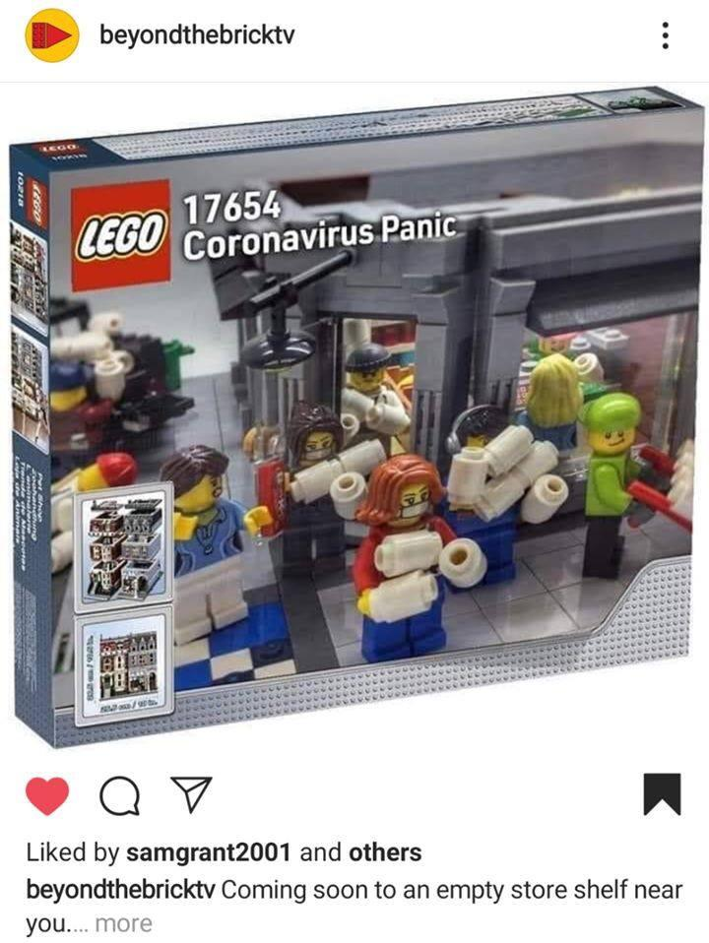
COVID-19
Notes:
Restatement

Slide 24
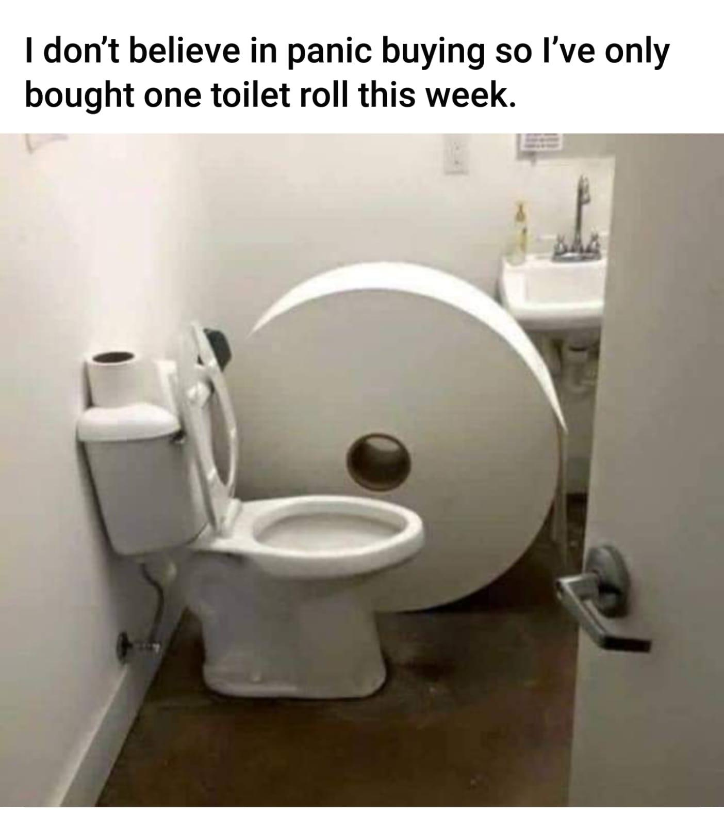
COVID-19
I don't believe in panic buying so I've only bought one toilet roll this week.
Notes:
Restatement

Slide 25
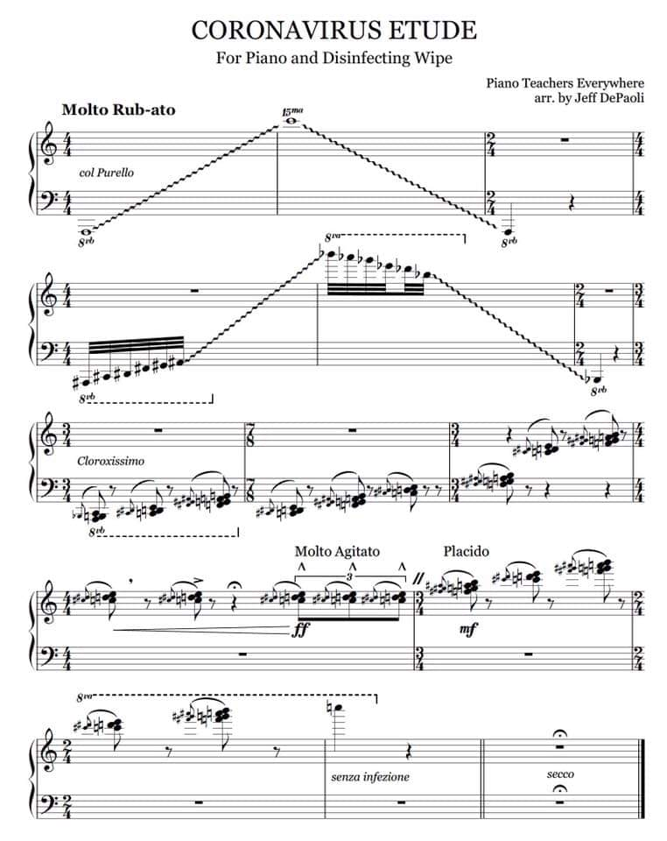
COVID-19
CORONAVIRUS ETUDE
For Piano and Disinfecting Wipe
Notes:
Restatement

Slide 26
Do you know someone who does not like humour?
It seems that we are not treading on dangerous ground here. Try to loosen people up a bit!

Slide 27
INTRODUCING OUR PANEL…
254
Dr Roy Low
Pastor Jim Eng

Slide 28
WHY SO LEFT BRAIN?

Slide 29
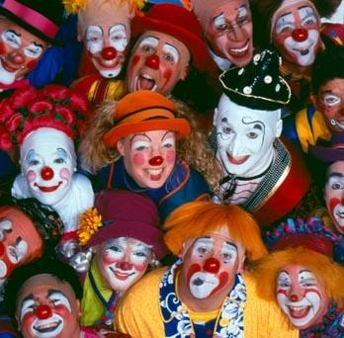
How to Be Funny

Slide 30
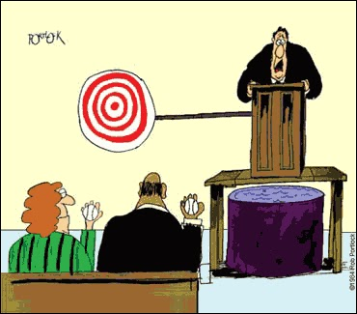
Dangers of Humour

Slide 31
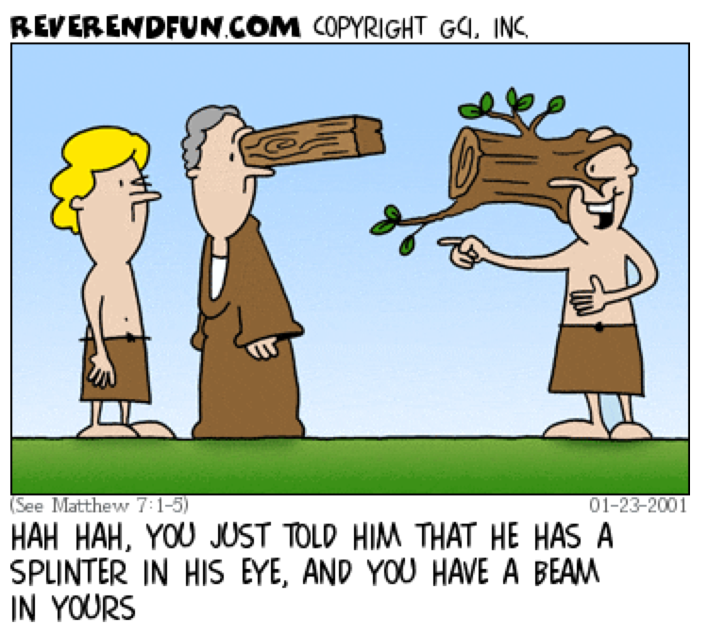
JESUS WAS FUNNY!
Hah hah, you just told him that he has a splinter in his eye and you have a beam in yours.

Slide 32
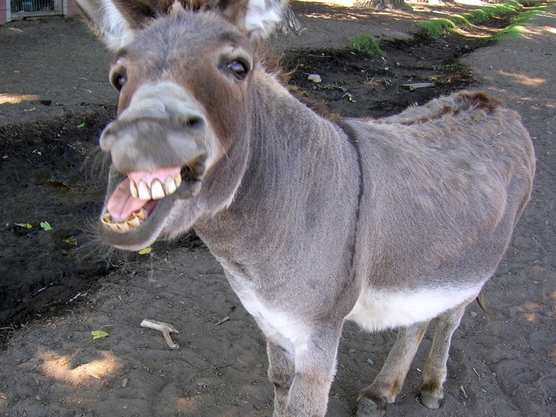
BLACK

Slide 33
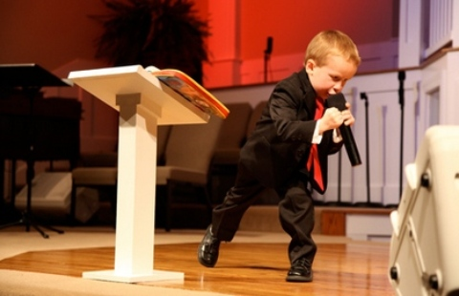
Go for it!
Notes:
The USA has a 4-year-old child preacher…
Kanon Tipton, 4, first took the microphone at his family's church when he was just 21 months old. Two years and a few million YouTube hits later, the young preacher has developed quite a reputation. His emotional delivery, dramatic cadence and back-and-forth pacing behind the pulpit are faithful replications of the mannerisms he's seen demonstrated by other preachers.
On Tuesday, Kanon and his parents appeared on NBC's The Today Show to talk about the young preacher's amazing talent. Asked whether he thought Kanon has a true calling for ministry or if he was merely mimicking what he had seen from others, Kanon's father, Pastor Damon Tipton, said, "I think it's a little of both ... I do feel like the hand of God is on him in a special way." Kanon is the third generation of preachers in his family, following in the footsteps of both his father and grandfather.
https://www.huffpost.com/entry/kanon-tipton-child-preacher_n_928208
Kanon Tipton, 4-Year-Old Preacher, Gains YouTube Fame (VIDEO)
WATCH: 4-Year-Old Preaching Sensation
Aug 16, 2011, 11:56 AM EDT| Updated Dec 6, 2017
Accessed 28 Jan 2024

Slide 34
Don't think that the Scripture itself isn't funny!

Slide 35
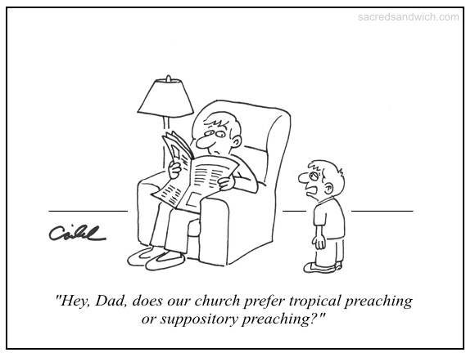
Suppository Preaching
"Hey, Dad, does our church prefer topical preaching or suppository preaching?"

Slide 36
BLACK

Slide 37
Preaching (Homiletics) link at BibleStudyDownloads.org
Get this presentation for free!
Notes:
Preaching (pr)
Homiletics

